Slide 1
Property Inspection Demo
Preparation and Walkthrough

Slide 2
Preparing Calendars
Log into OWA with Ron Gabel and delete all calendar events for the day after the demo. For example, if you are doing the demo on the October 28 then delete all entries on the October 29.
This step is done to make the calendar clean so it is easy to see the new calendar invites that are added with the Unified API.

Slide 3
Walkthrough
These following slides describe how to execute the demo, the lists items that are modified during each step, and the emails which are sent.

Slide 4
Inspection Walkthrough
The inspector arrives at the property and uses the Inspection mobile app to report inspection findings.

Slide 5
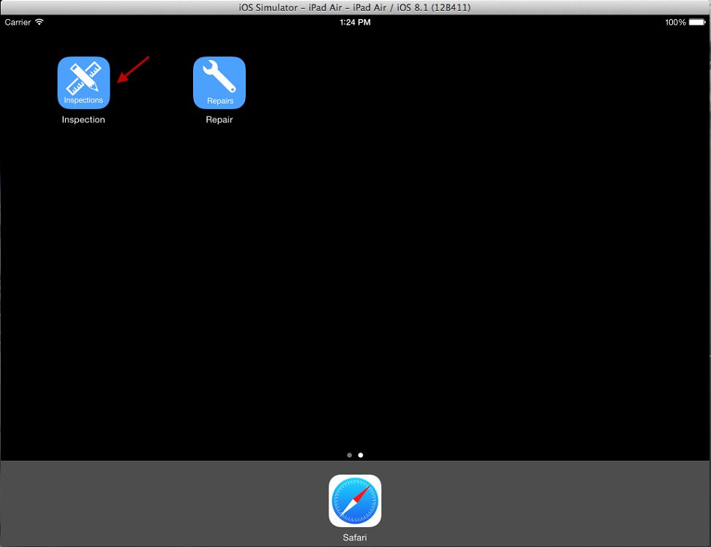
Open Inspection App on device
In this demo script the screenshots for the mobile devices were taken in the iOS simulator.
The steps are identical in the iOS, Android, Cordova, Xamarin, and Windows Universal mobile apps.

Slide 6
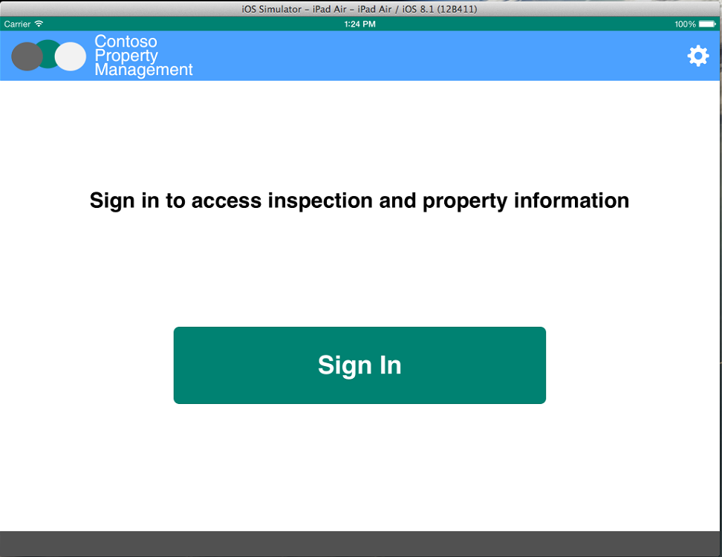
Click Sign In

Slide 7
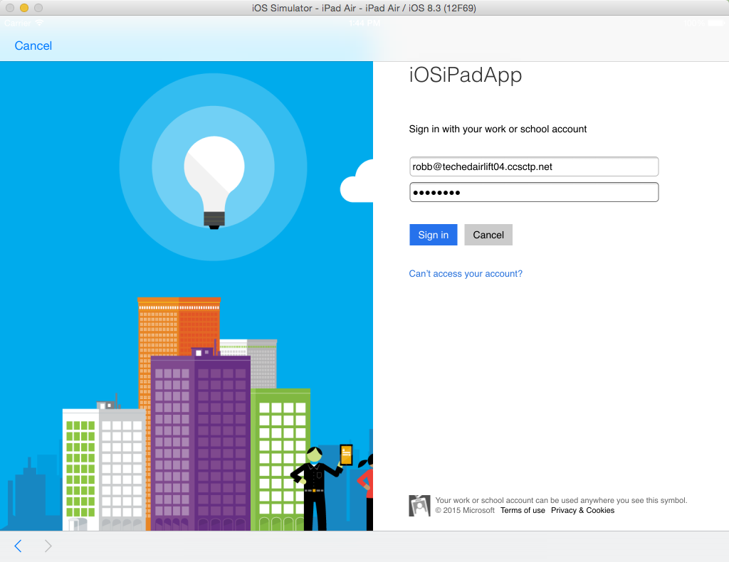
Enter inspector credentials Username: robb@<tenanacy>.onmicrosoft.com Password: TempP@ssw0rd! (default) Do not check Keep Me Signed In Click Sign In If you have not already signed in with this user you will be prompted to reset the user’s password.

Slide 8
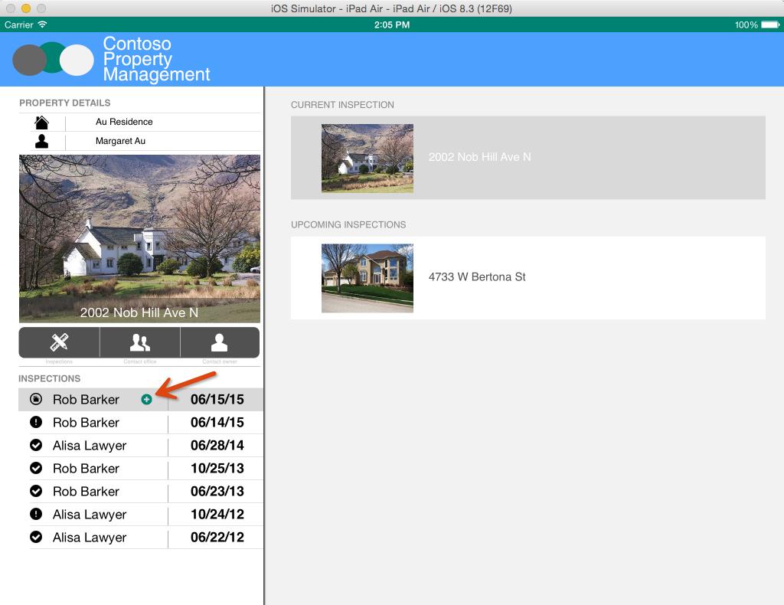
Click the inspection with the plus icon

Slide 9
Submitting an inspection comment
Inspection comments are informational, they do not require action or indicate anything is wrong.

Slide 10
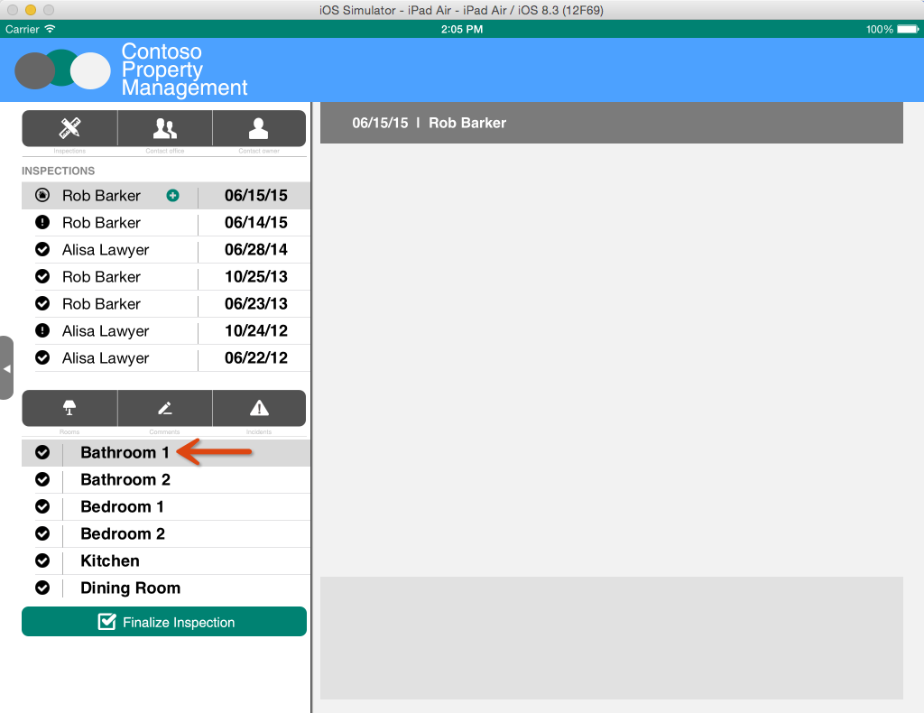
Select Bathroom 1

Slide 11

Click Comments

Slide 12
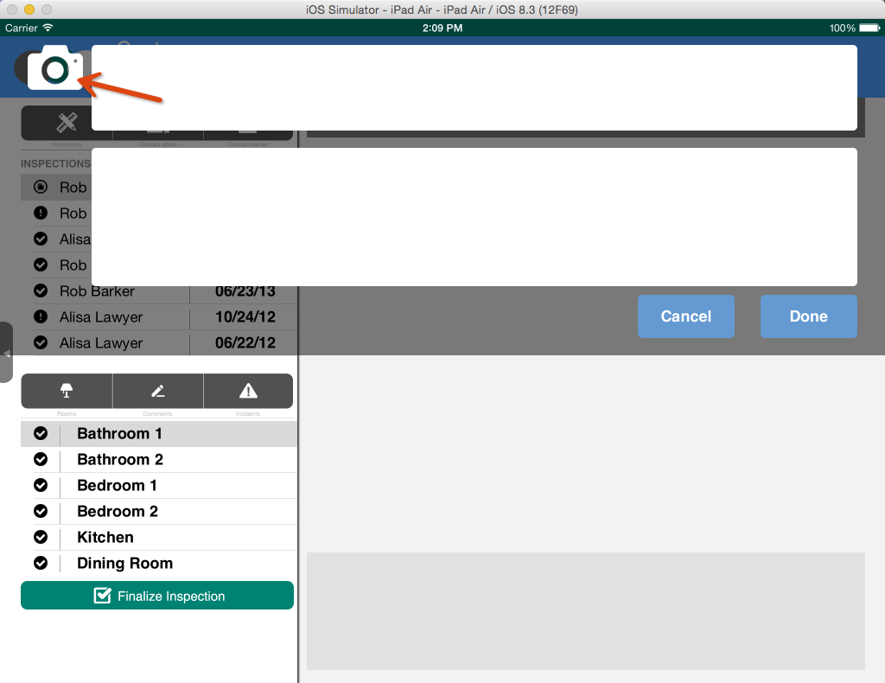
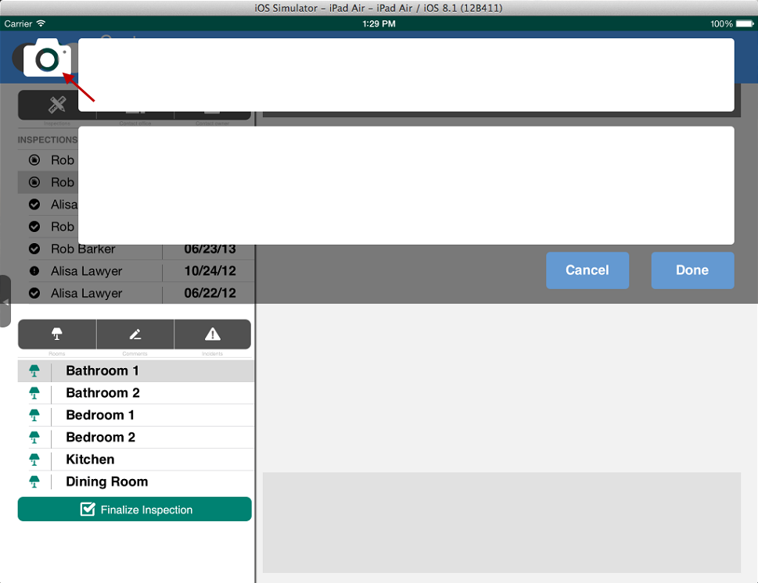
Click Camera

Slide 13
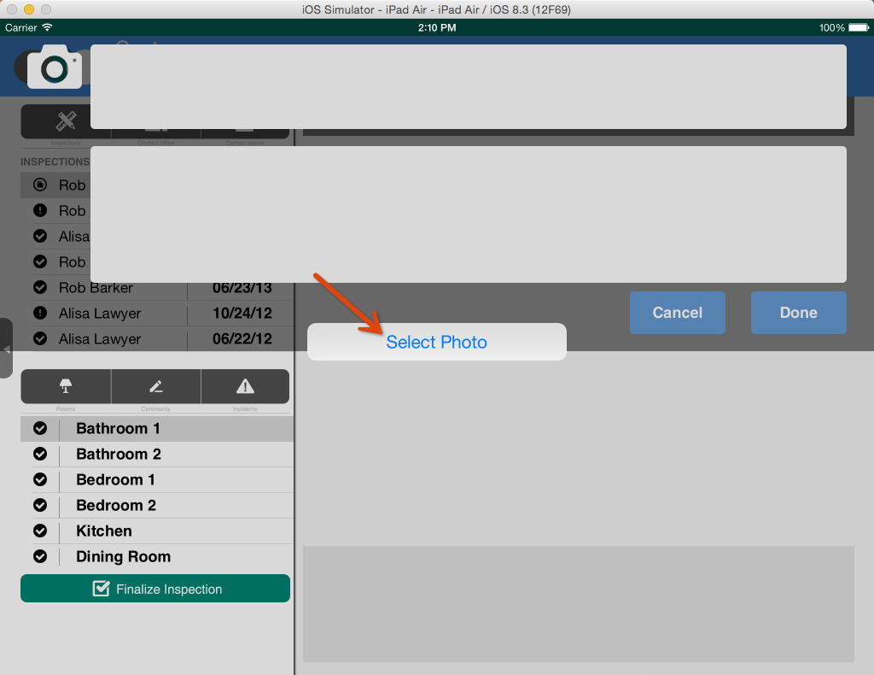
Select photo or take picture
If you are running on a physical device you will be able to use the device’s camera to take a photo.
If you are running in the simulator you will be able to take a photo with your computer’s web cam if you have your simulator configured to use the web cam.
If you do not have a camera configured you will be able to select a photo.

Slide 14
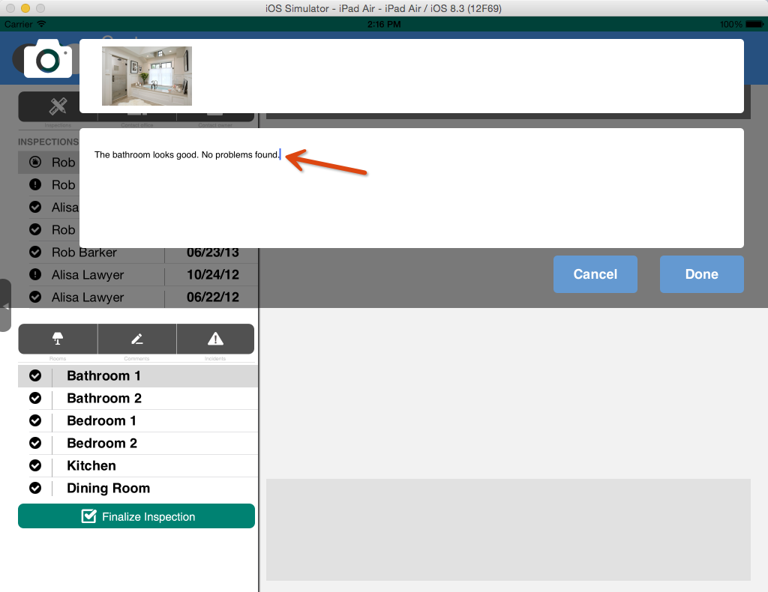
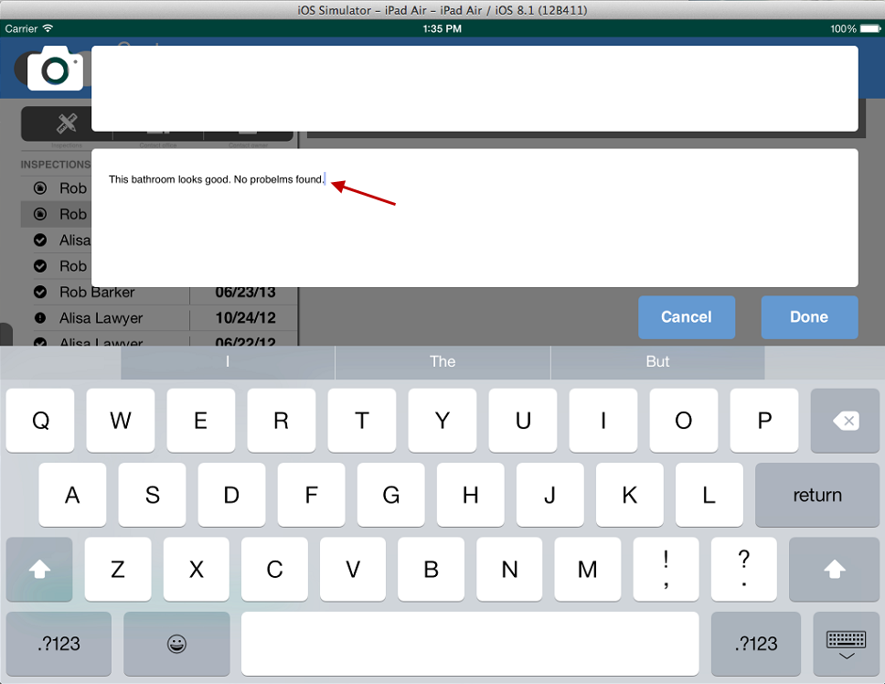
Enter Comments

Slide 15
Click Done
Picture is uploaded to Room Inspection Photos Document Library
Inspection comment is created in Inspection Comments List

Slide 16
Submitting an incident
Incidents indicate there is a problem that needs to be repaired.

Slide 17
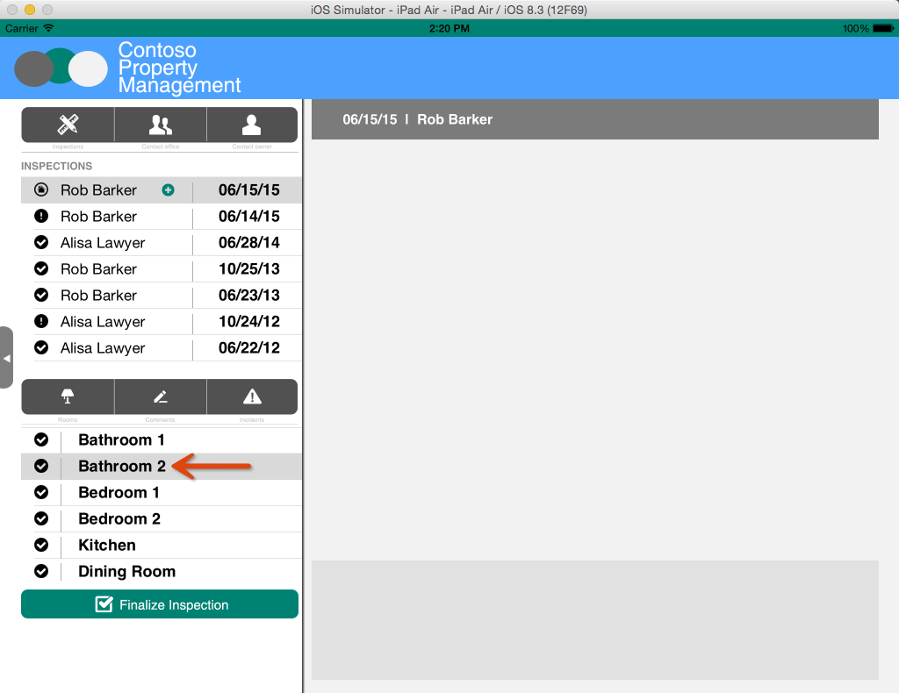
Select Bathroom 2

Slide 18
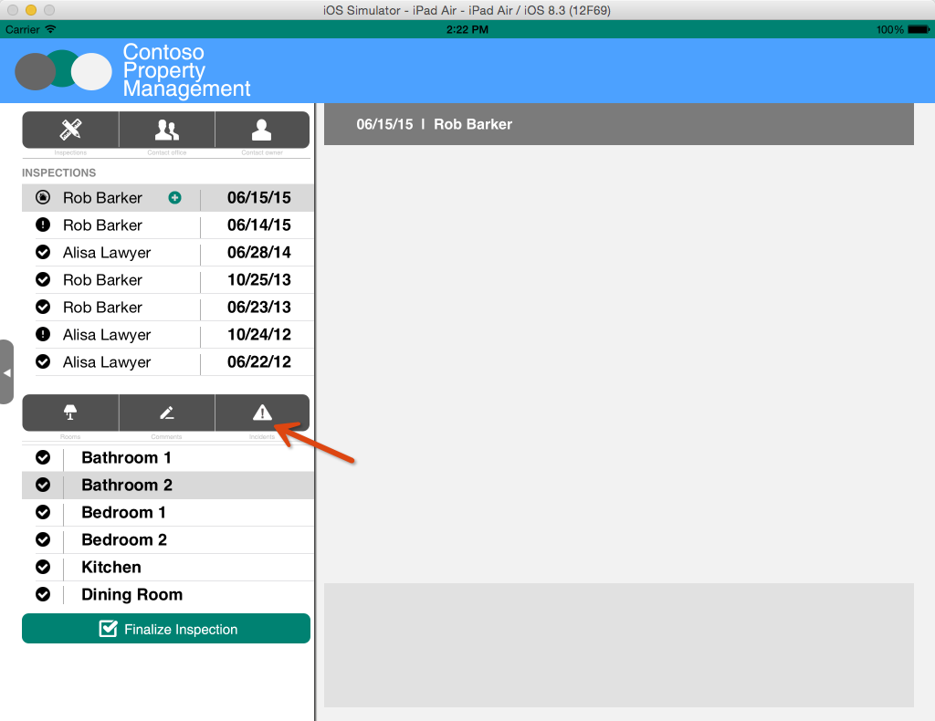
Click Incidents

Slide 19
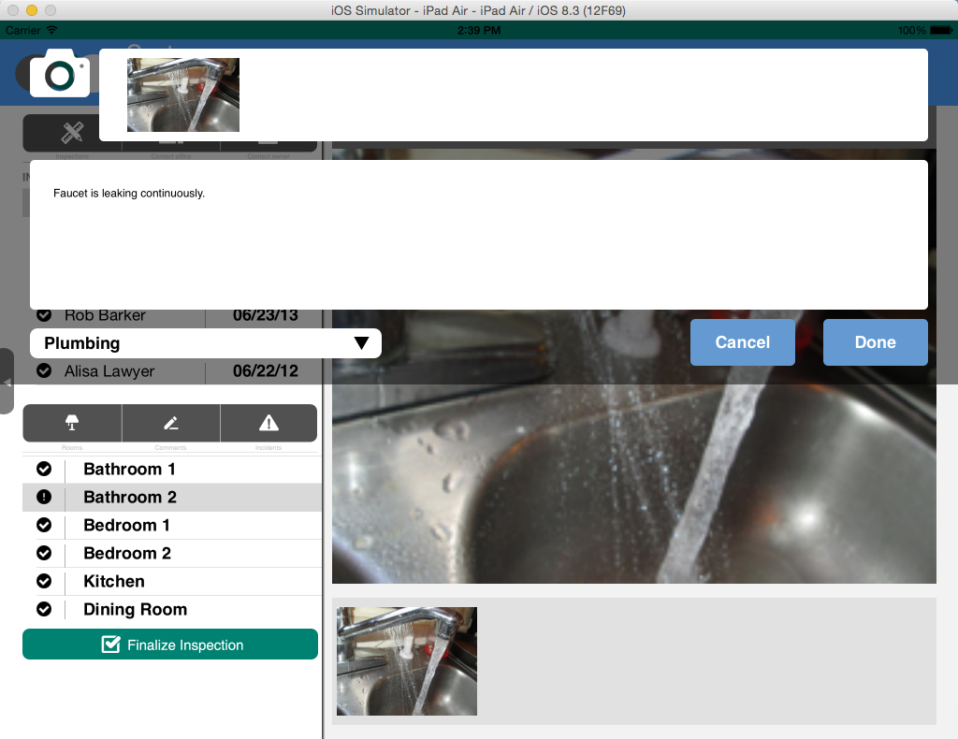
Just like you did in the Inspection Comments popup, take a picture and enter comments. Then, select an Incident Type and click Done.
Incident is created in Incidents List
Photo is added to Room Inspection Photos Document Library
Workflow Task is created for Dispatcher

Slide 20
Not in scope at this time Click Video Need to add a new button to this page to create videos.

Slide 21
Not in scope at this time Select video or record video

Slide 22
Not in scope at this time Video is uploaded to Office 365 Video Portal
Video is added to Office 365 Video Portal in the Incidents channel.

Slide 23
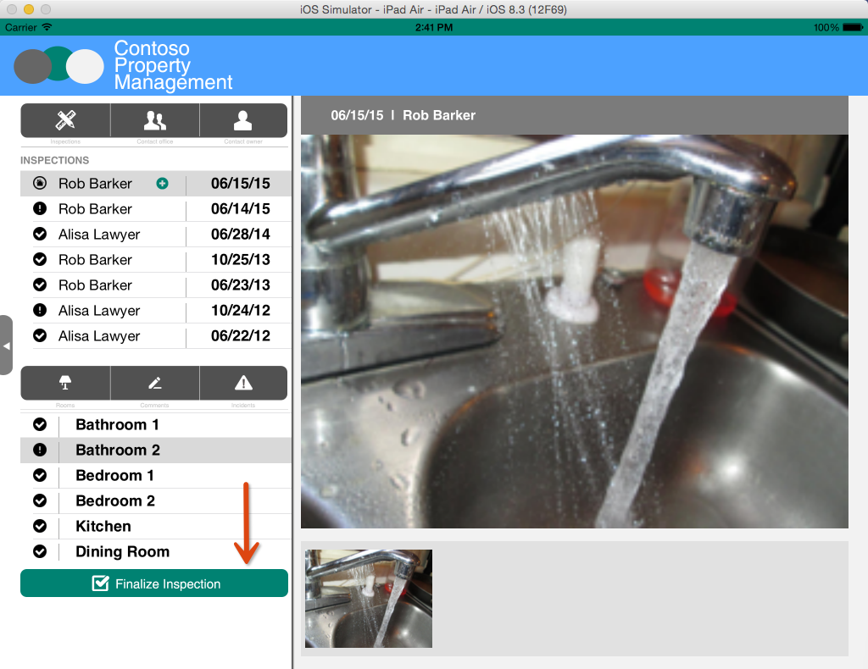
Click Finalize Inspection

Slide 24
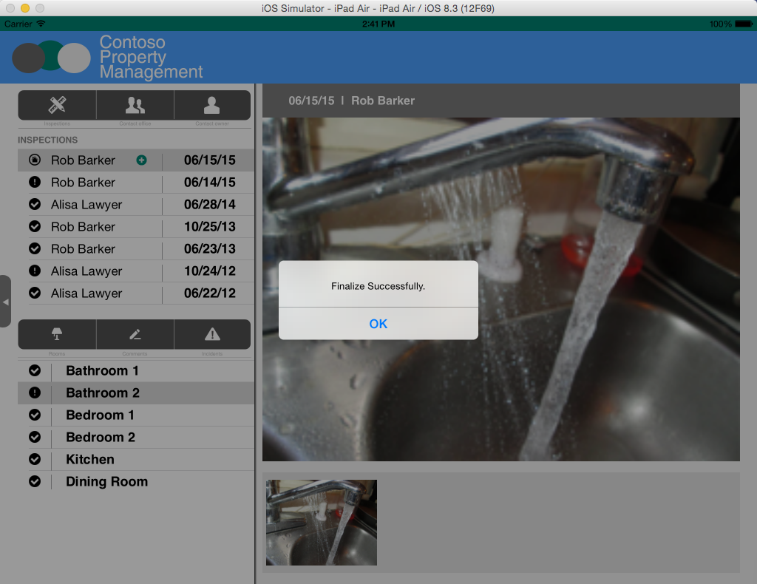
Get Confirmation
Inspection in Inspections List is updated with Finalized Date

Slide 25
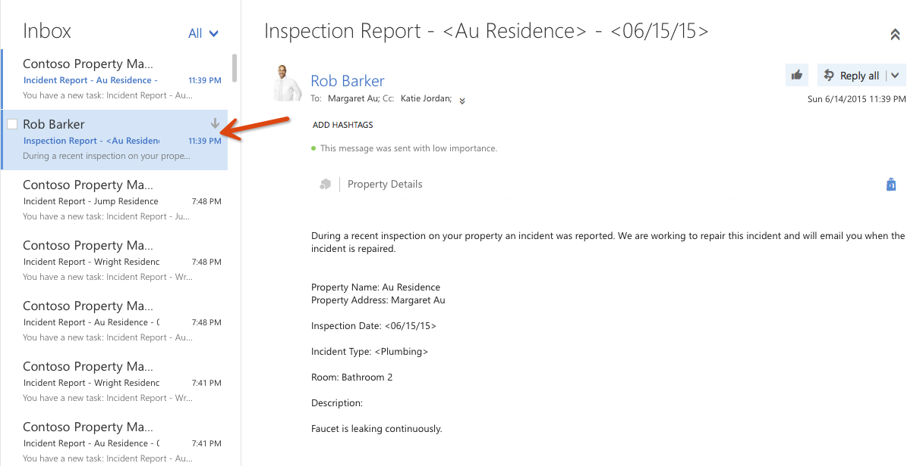
Inspection report email is sent to property owner and dispatcher Log in with Dispatcher account to see the email Username: katiej@<tenanacy>.onmicrosoft.com Password: TempP@ssw0rd! If you have not already signed in with this user you will be prompted to reset the user’s password.

Slide 26
Dispatcher Scheduling Walkthrough
The dispatcher reviews the incident found at the property and schedules a repair.

Slide 27
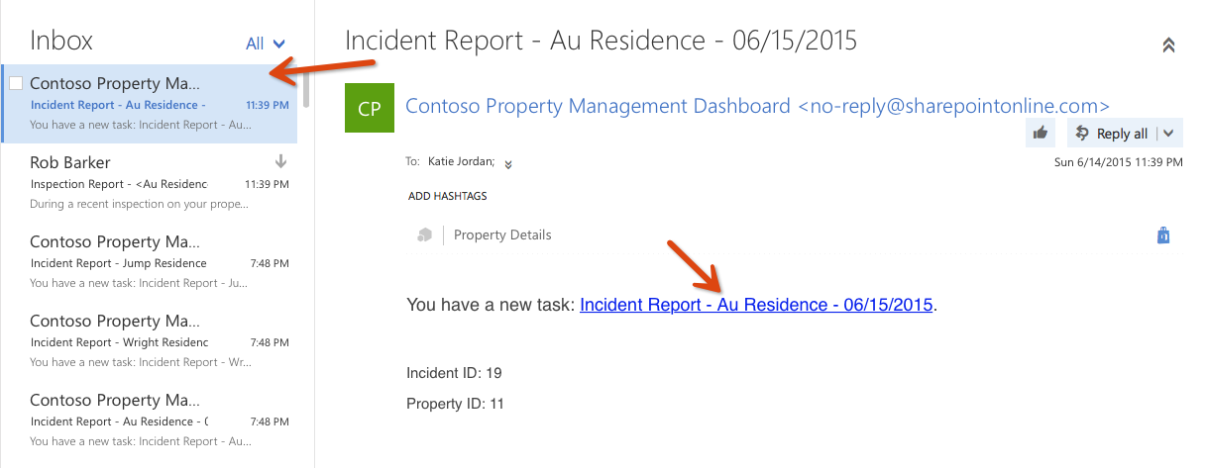
Inspection report email is sent to property owner and dispatcher Log in with Dispatcher account to see the email Username: katiej@<tenanacy>.onmicrosoft.com Password: TempP@ssw0rd! If you have not already signed in with this user you will be prompted to reset the user’s password.

Slide 28
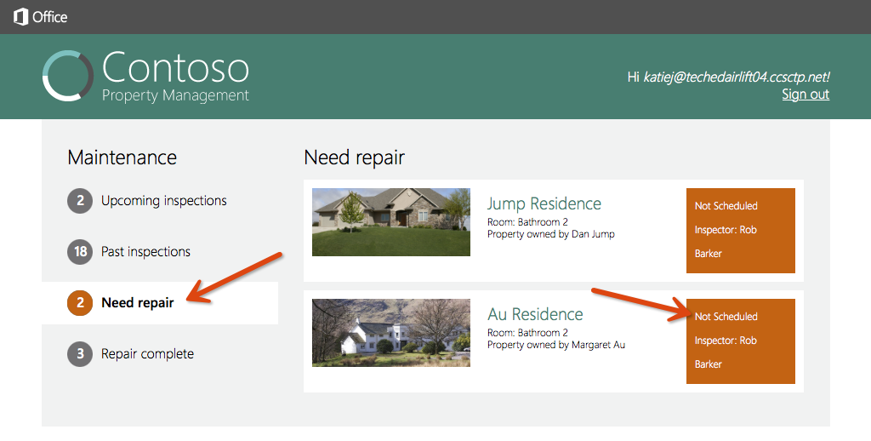
Open the Property Management Web App Dashboard and click Need Repair

Slide 29
Click Not Scheduled

Slide 30
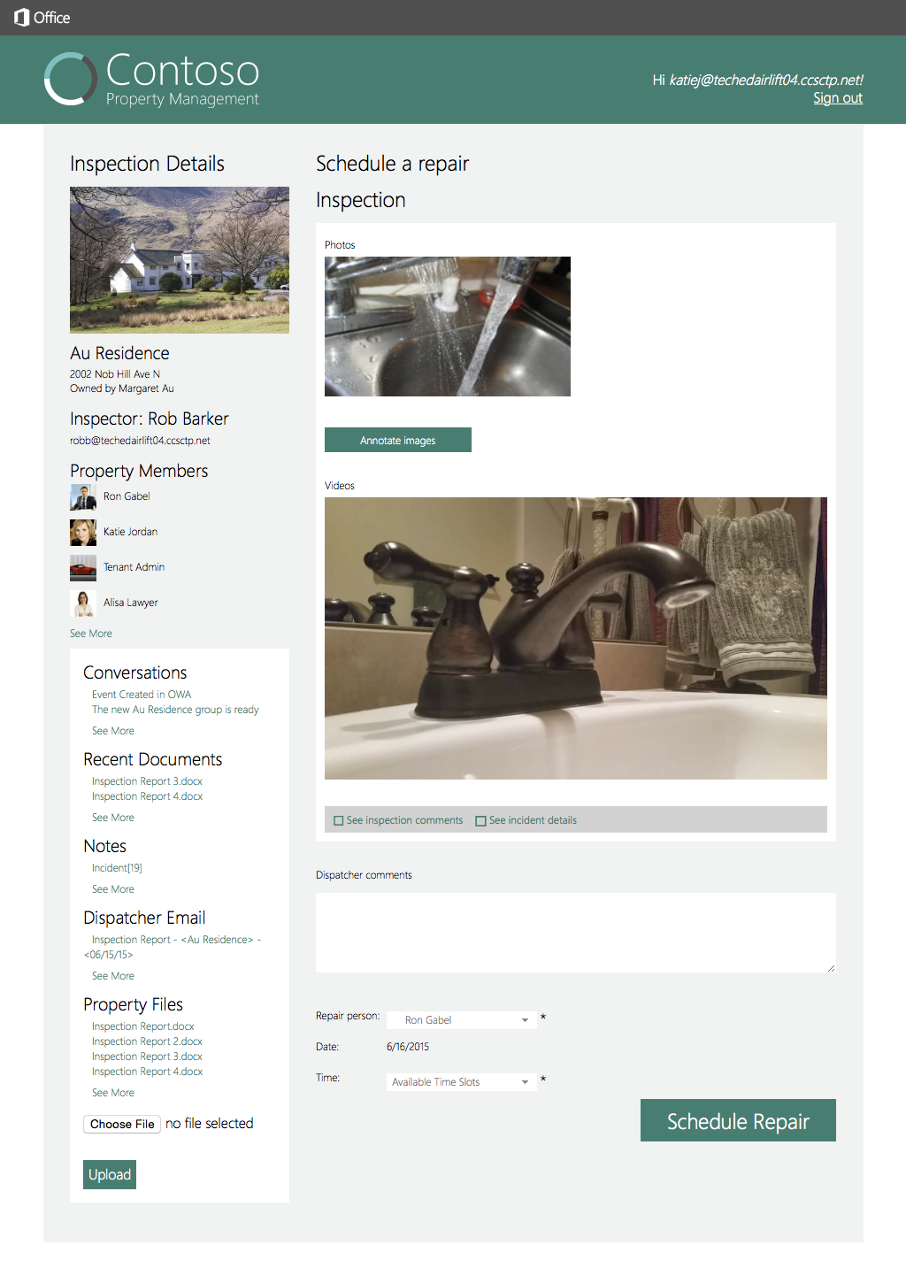
View the members associated with the Unified Group corresponding to this property.
Members

Slide 31
View the videos associated with the incident. Click one of the videos in the page and a new browser window opens to view the video.
Videos

Slide 32
View the conversations associated with the Unified Group corresponding to this property. Click one of the conversations in the list and a new browser window opens to view the conversation.
Conversations

Slide 33
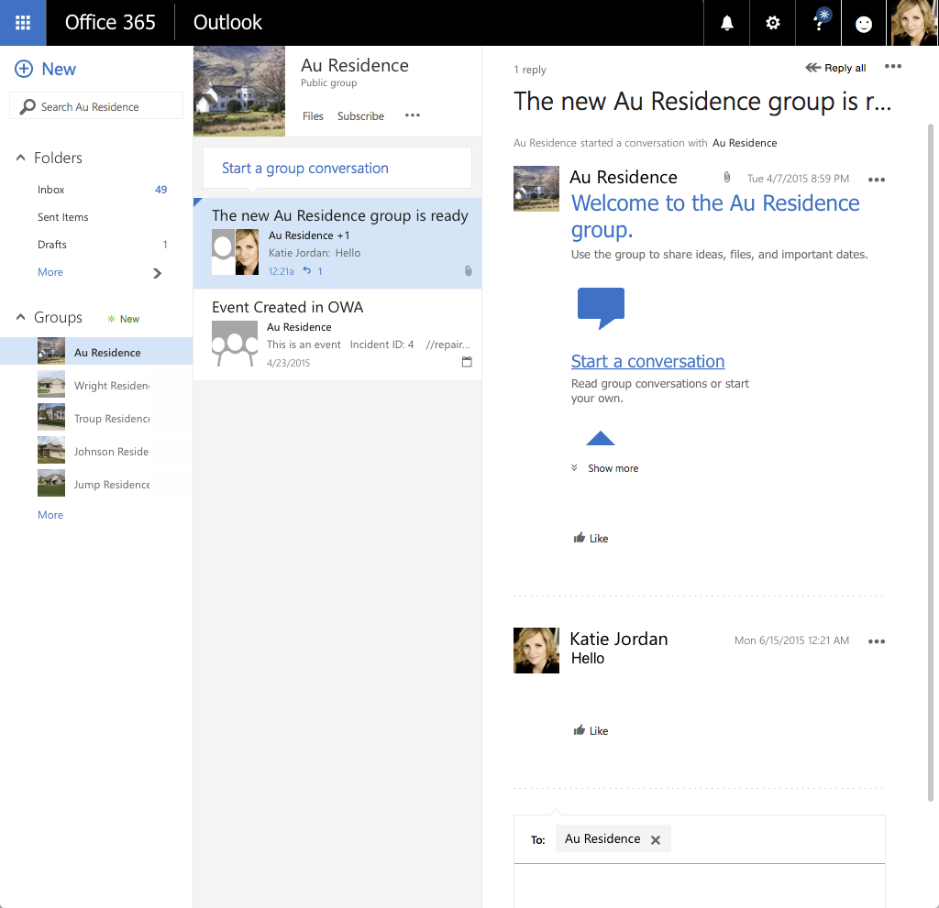
View the conversation in a new web browser.

Slide 34
View the a recent document associated with the Unified Group corresponding to this property. Recent documents are documents that have been modified in the last 7 days. Click one of the documents in the list and a new browser window opens to view the document.
Recent documents

Slide 35
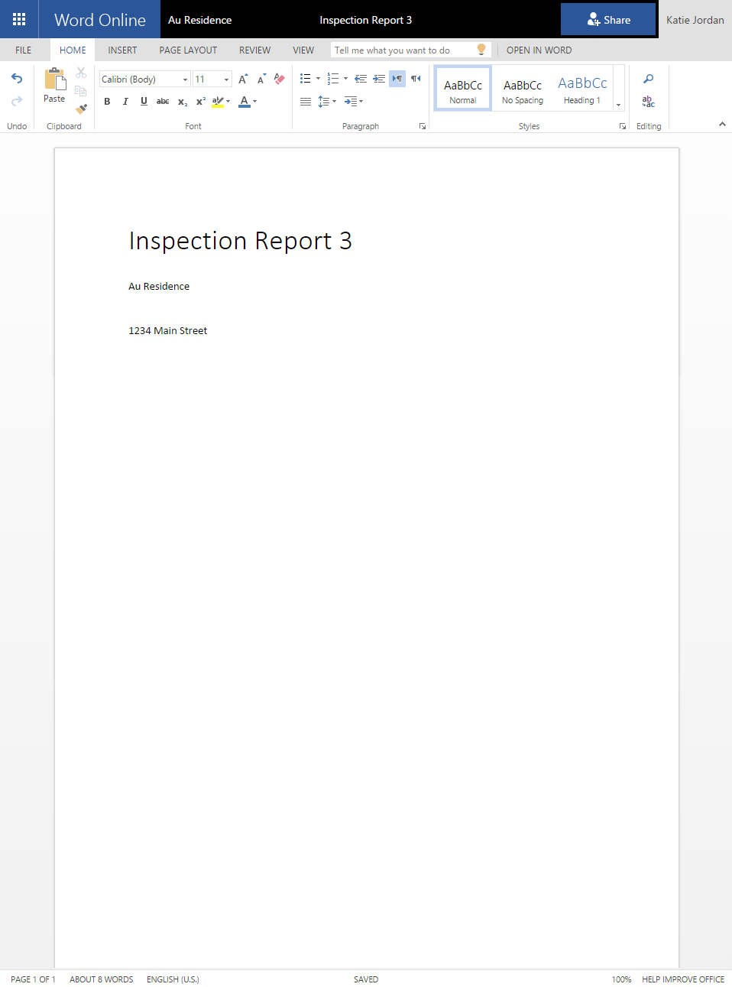
View the document in a new web browser.

Slide 36
View the documents associated with the Files library in the Unified Group corresponding to this property. Click the See more link at the bottom of the list and a new browser window opens to view the documents.
Documents

Slide 37
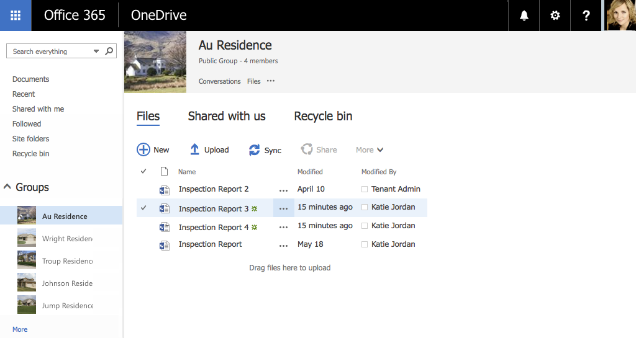
View the documents in a new web browser.

Slide 38
Click the Upload button to upload a document to the Files library in the Unified Group corresponding to this property. The page and list refresh after the file is uploaded.
Click Upload

Slide 39
Click the Annotate Images button to create a new page in the OneNote notebook in the Unified Group corresponding to this property.
Click Annotate Images

Slide 40
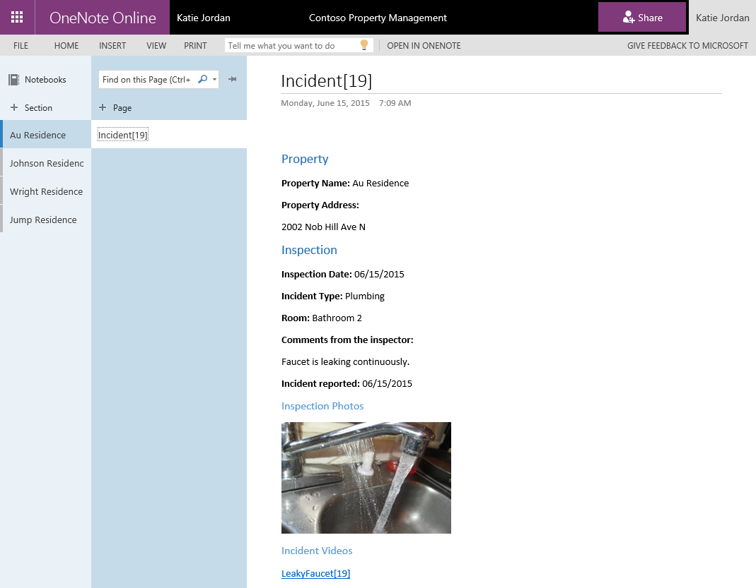
View the new OneNote page in a new web browser and make annotations to the images in it.

Slide 41
Click the create repair task button to create a new Task in the Tasks list in the Unified Group corresponding to this property.
This is not in PPE yet but the UX and code is stubbed out and currently the code is commented out.
A list that displays the Tasks associated with the current repair will be displayed in this page. Need to add a button to create a task.

Slide 42
View the Tasks in a new web browser. This is not in PPE yet so I cannot take a screenshot.

Slide 43
Enter comments, select Ron Gabel, select Time, click Schedule Repair
Incident in Incident List is updated to reflect Status, Repair Scheduled Date, and Repair Person assigned
Workflow Task for Dispatcher is completed
Workflow Task for Repair Person is created

Slide 44
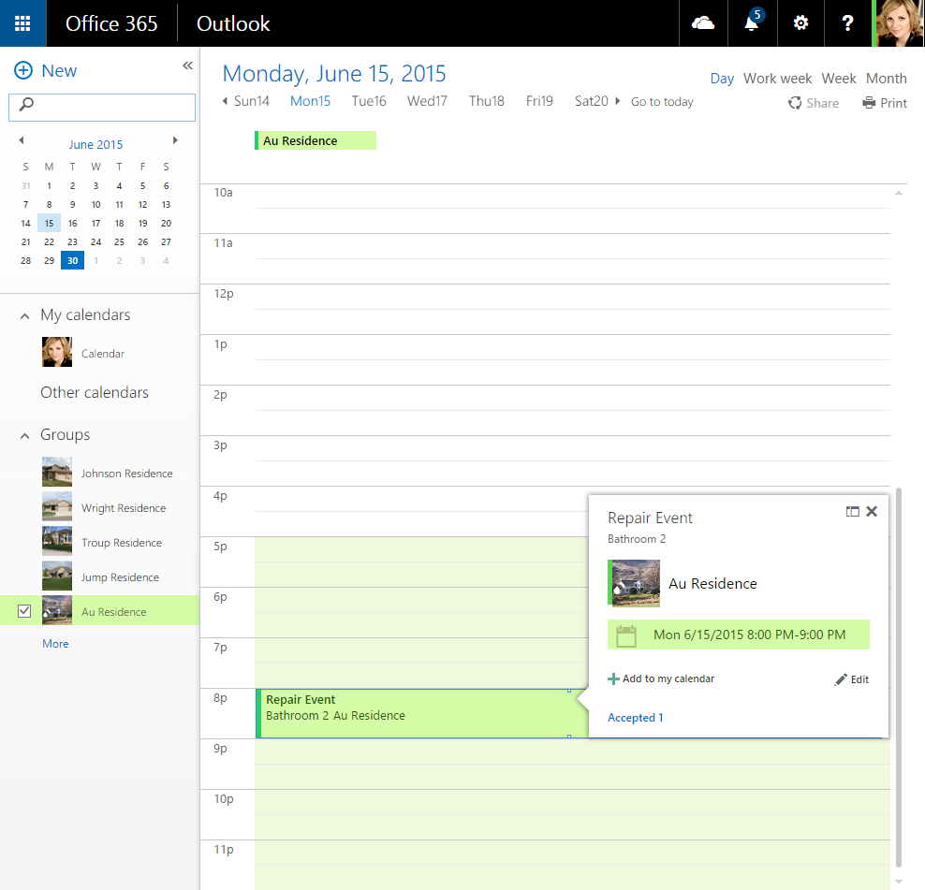
View the shared calendar for the Unified Group associated with the property in a new web browser. Click the new event.

Slide 45
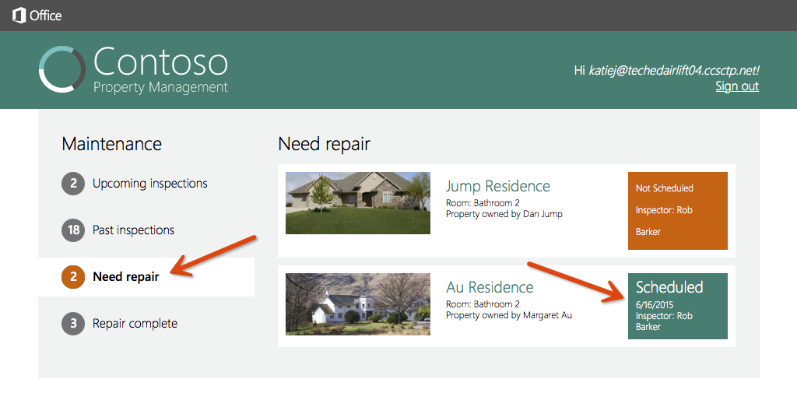
Click Need repair and mention the repair is scheduled

Slide 46
Repair Walkthrough
The repair person reviews the incident found at the property, repairs the incident, documents the repairs, and submits the repair for approval.

Slide 47
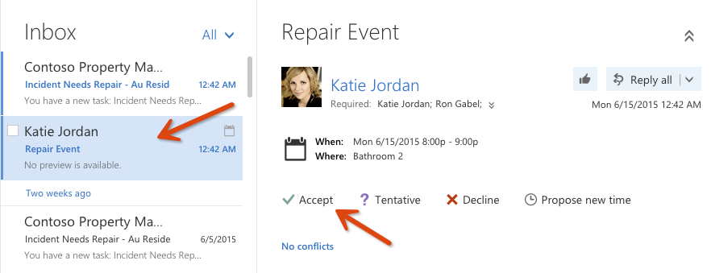
Accept repair event Log in with thhe Repair Person account to see the email for the repair event Username: rong@<tenanacy>.onmicrosoft.com Password: TempP@ssw0rd! If you have not already signed in with this user you will be prompted to reset the user’s password.

Slide 48
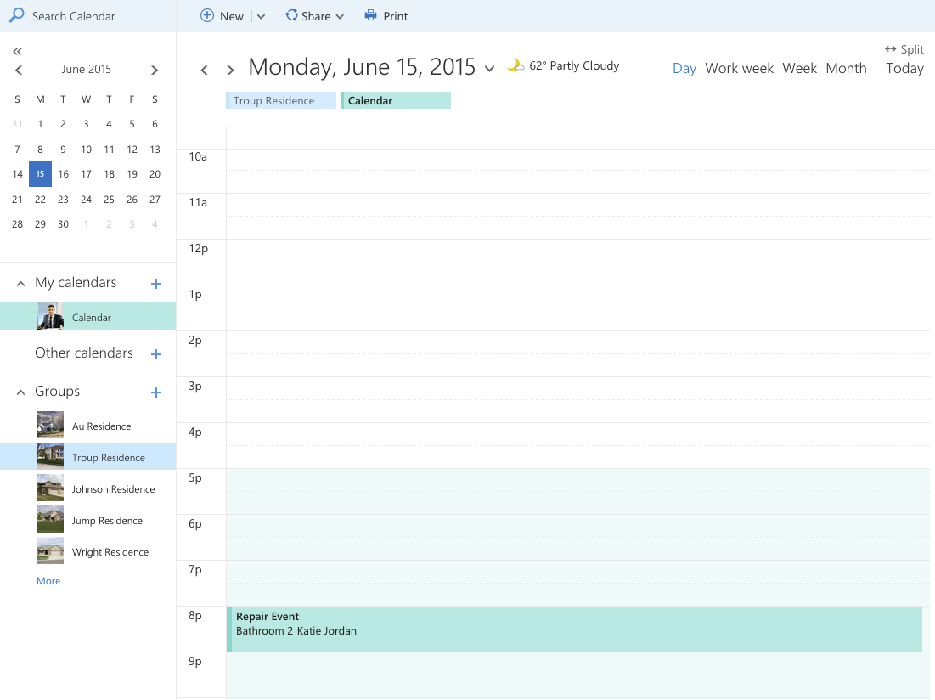
View calendar event and accept it

Slide 49
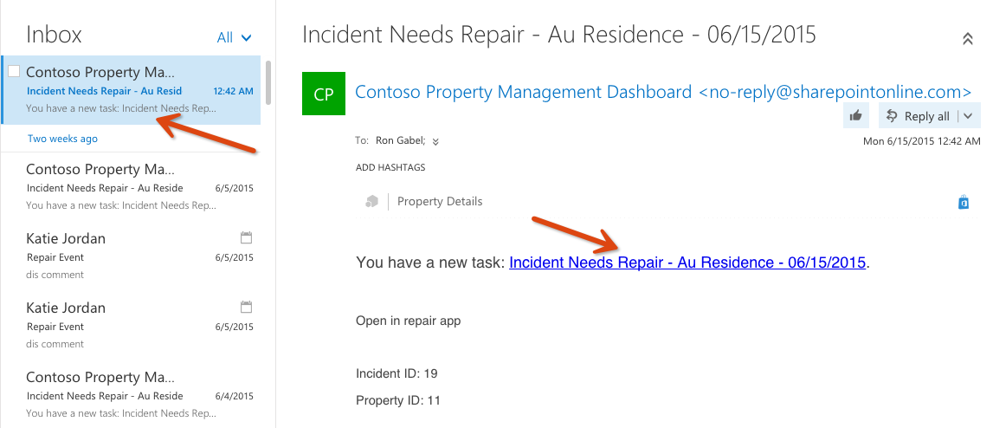
View repair task email sent to Ron Gabel
In order open the Repair iOS app you can click the Open in repair app link when you are viewing this email in the native iOS Mail client.
If you are not using the native iOS Mail client to view the email. Open Safari on your iOS Simulator or your iPad where the app is installed. Enter repairapp://<Incident ID> in the URL textbox and press enter, where <Incident ID> is equal to the Incident ID in the email.
In the example on this slide you would enter repairapp://19 in Safari on your iOS Simulator or iPad.

Slide 50
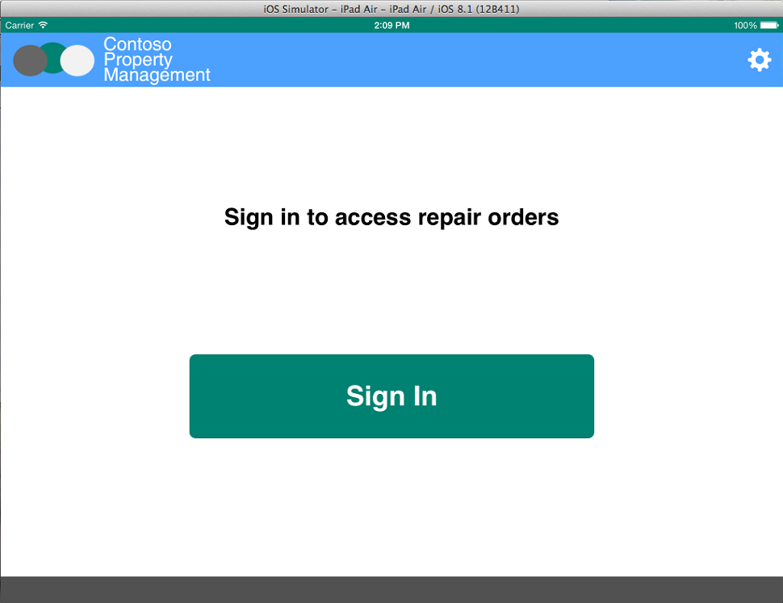
Click Sign In

Slide 51
Enter Repair Person credentials Username: robb@<tennacy>.onmicrosoft.com Password: TempP@ssw0rd! Do not check Keep Me Signed In Click Sign In If you have not already signed in with this user you will be prompted to reset the user’s password.

Slide 52
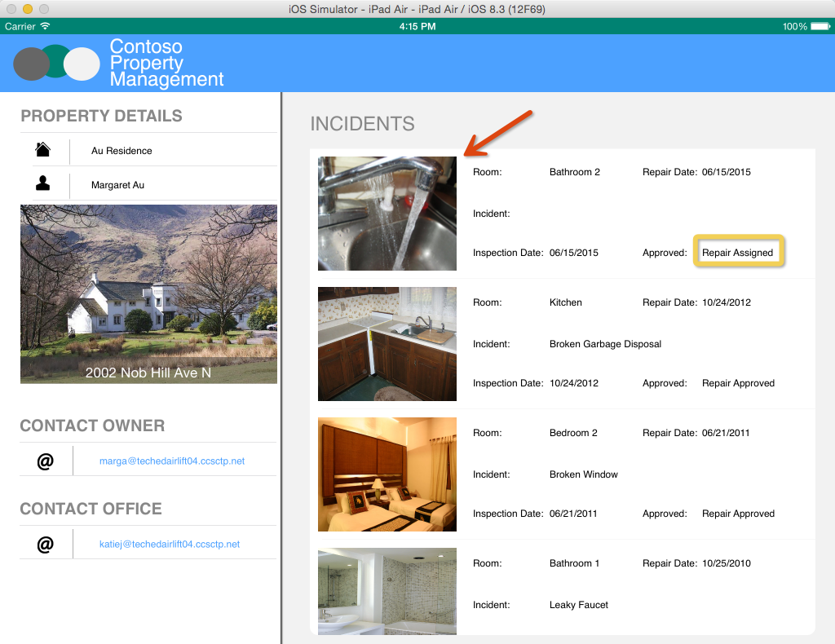
Click the incident assigned by the dispatcher

Slide 53
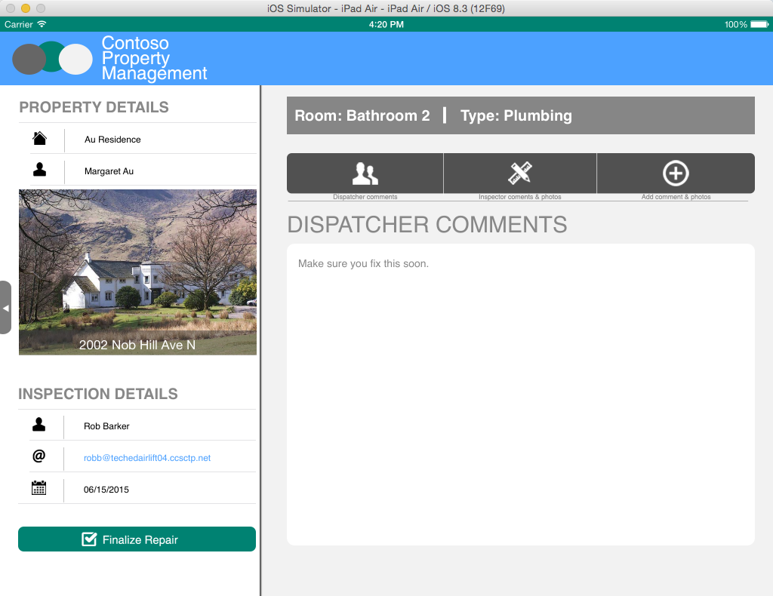
Review the dispatcher’s comments

Slide 54
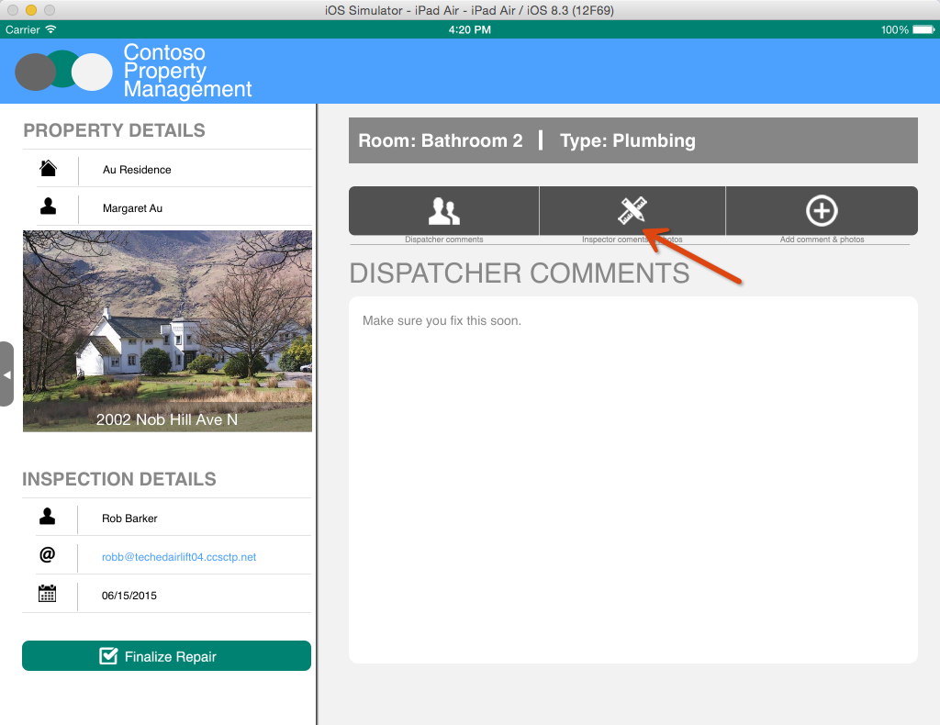
Click Inspector comments and photos

Slide 55
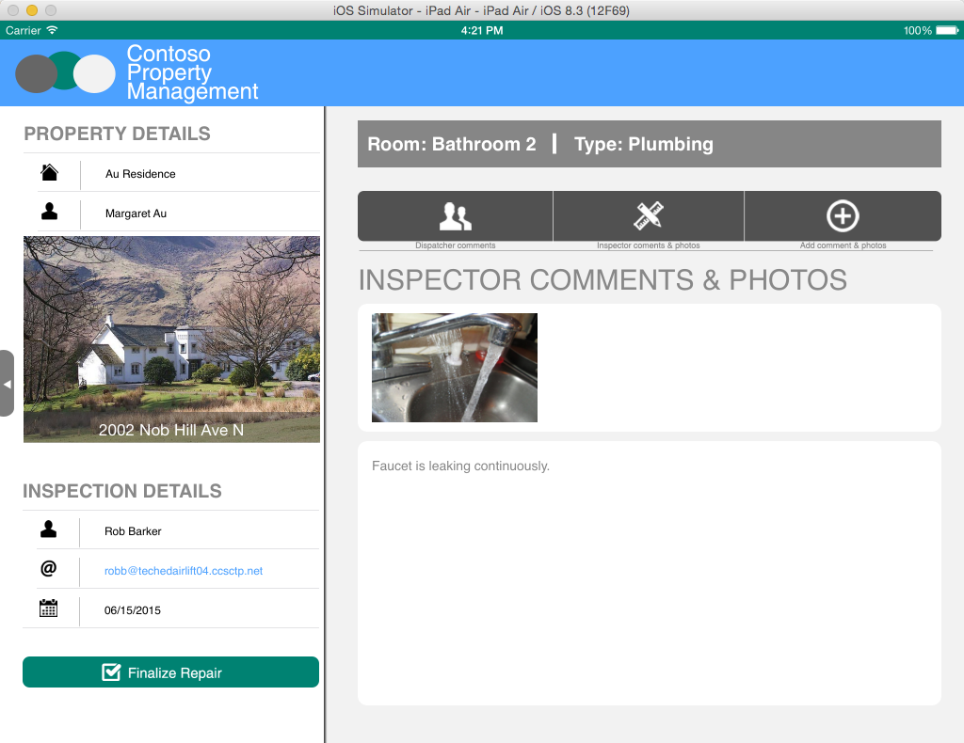
Review inspector comments

Slide 56
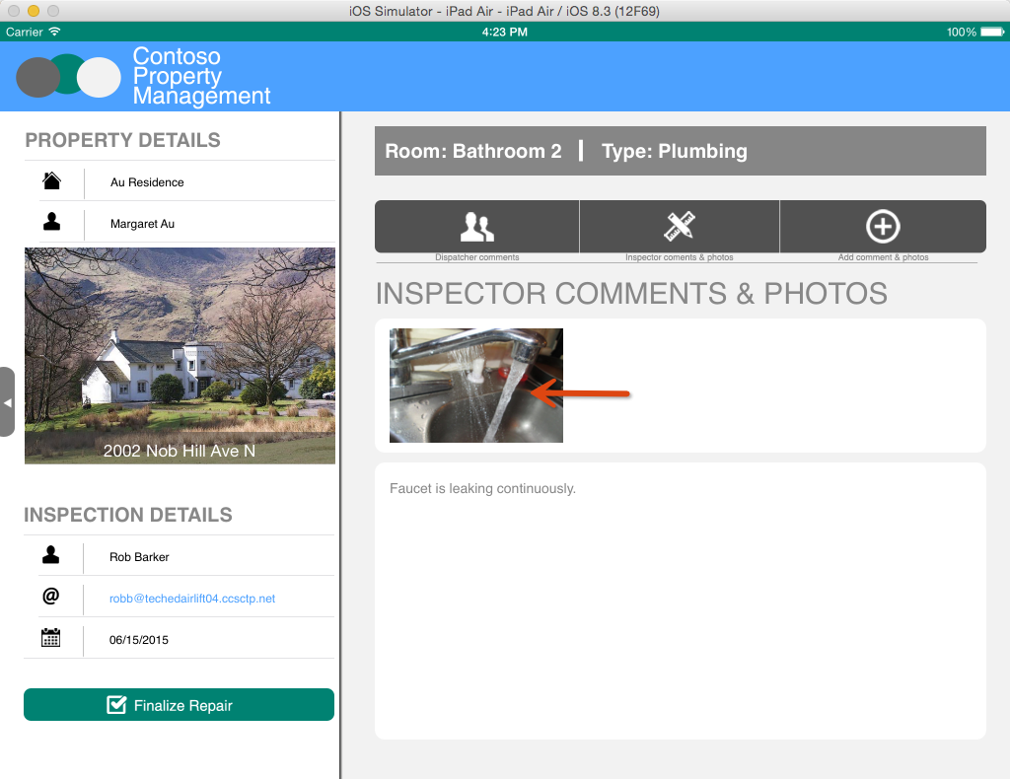
Click photo

Slide 57
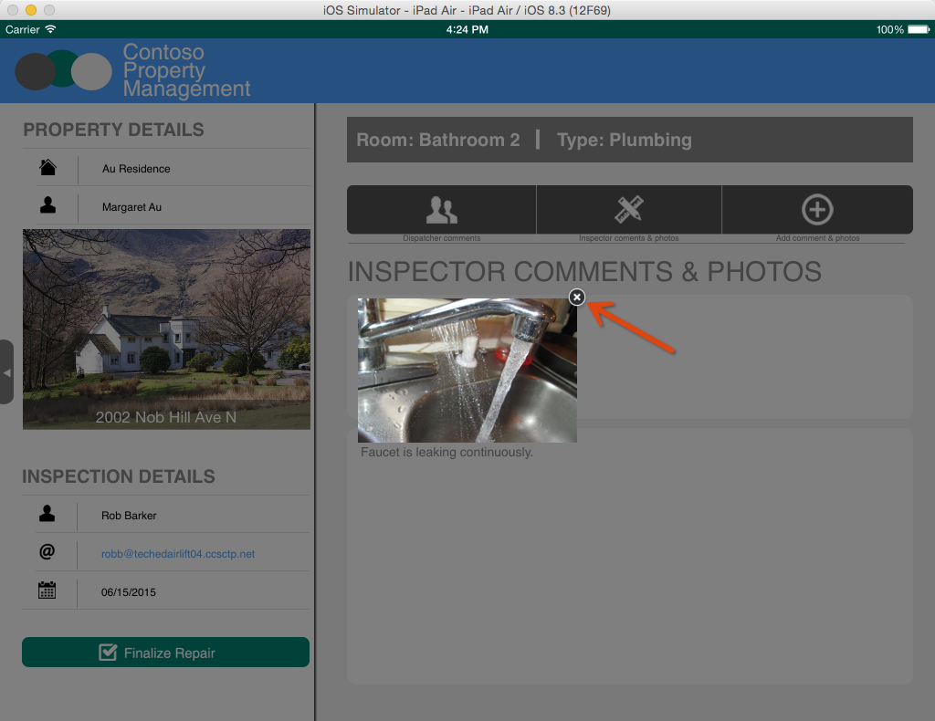
View photo full size, Click the X to close

Slide 58
Not in scope at this time Need to display the conversations, tasks, files, and videos here too.

Slide 59
Not in scope at this time Click Video Need to add a new button to this page to create videos.

Slide 60
Not in scope at this time View Video Full Size, Click X to Close

Slide 61
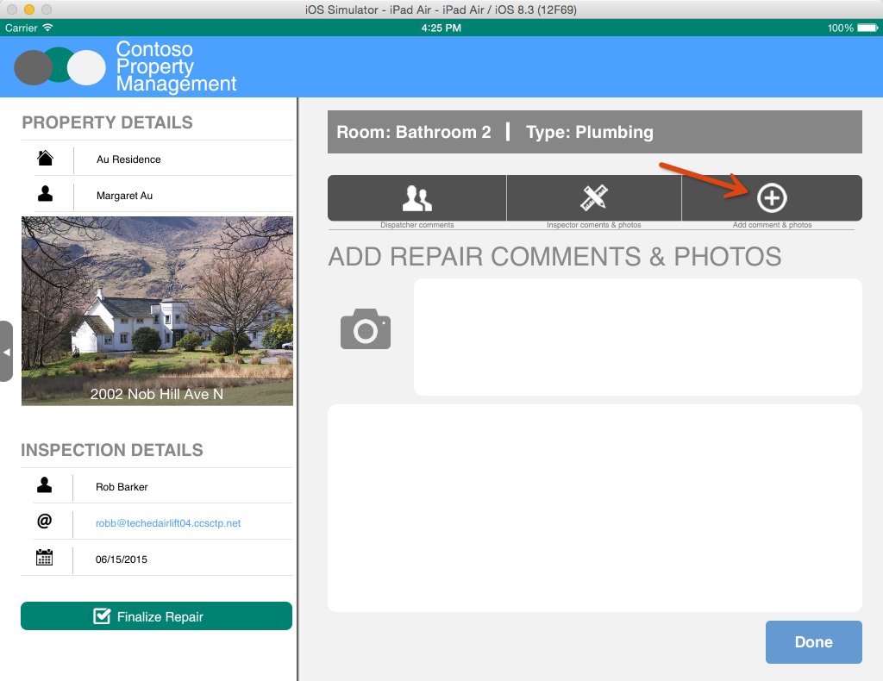
Just like you did in the Inspection App, take a picture and enter comments. Then, tap Done.

Slide 62

Not in scope at this time Just like you did in the Inspection App, record a video and enter comments. Then, tap Done.
Need to add a new button to this page to create videos.

Slide 63
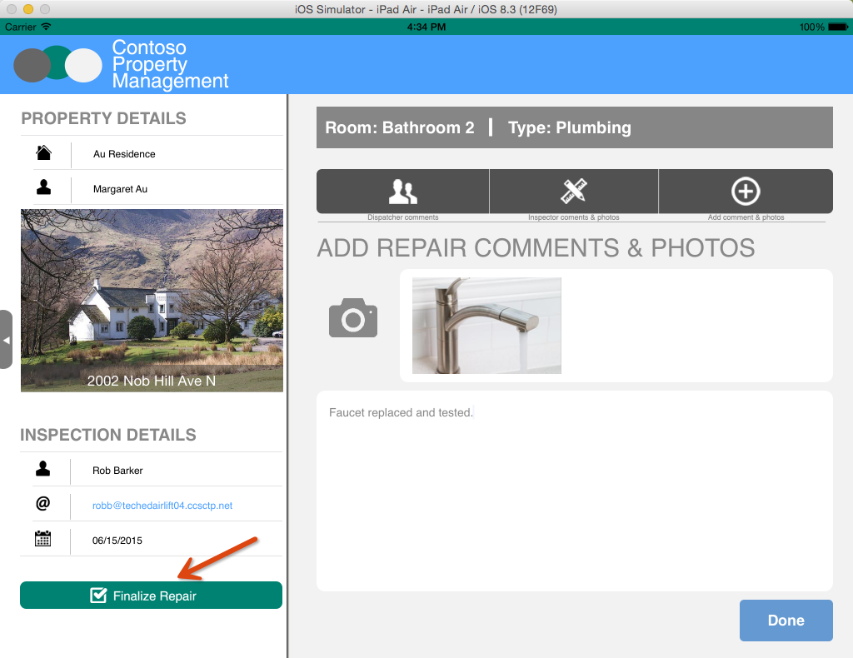
Click Finalize Repair
Incident List is updated with Repair comments, Status, and Repair Completed date
Photo is added to Repair Photos Library
Workflow Task for Repair Person is completed
Workflow Task for Dispatcher is created

Slide 64
Not in scope at this time Click Finalize Repair
Video is added to Video Portal.

Slide 65
Approve Repair Walkthrough
The dispatcher reviews the completed repair and approves it.

Slide 66
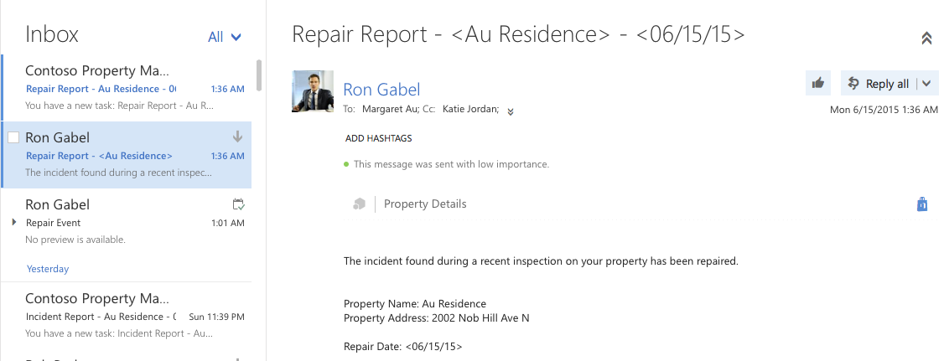
Email is sent to Property Owner and Dispatcher to tell them the repair is complete. Log in with dispatcher to view email. Username: katiej@<tennacy>.onmicrosoft.com Password: TempP@ssw0rd!

Slide 67
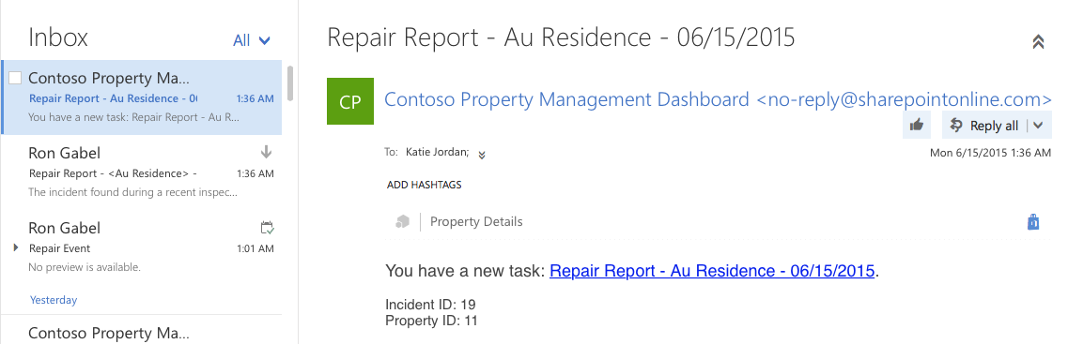
Email is sent to Dispatcher to approve repair. Log in with dispatcher to view email. Username: katiej@<tennacy>.onmicrosoft.com Password: TempP@ssw0rd!

Slide 68
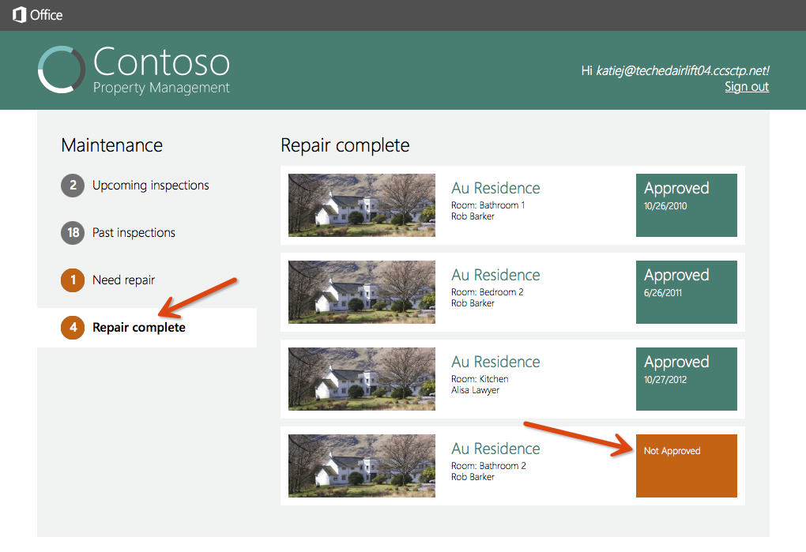
Refresh the Property Management Web App and click Repair complete

Slide 69
Click Not Approved

Slide 70
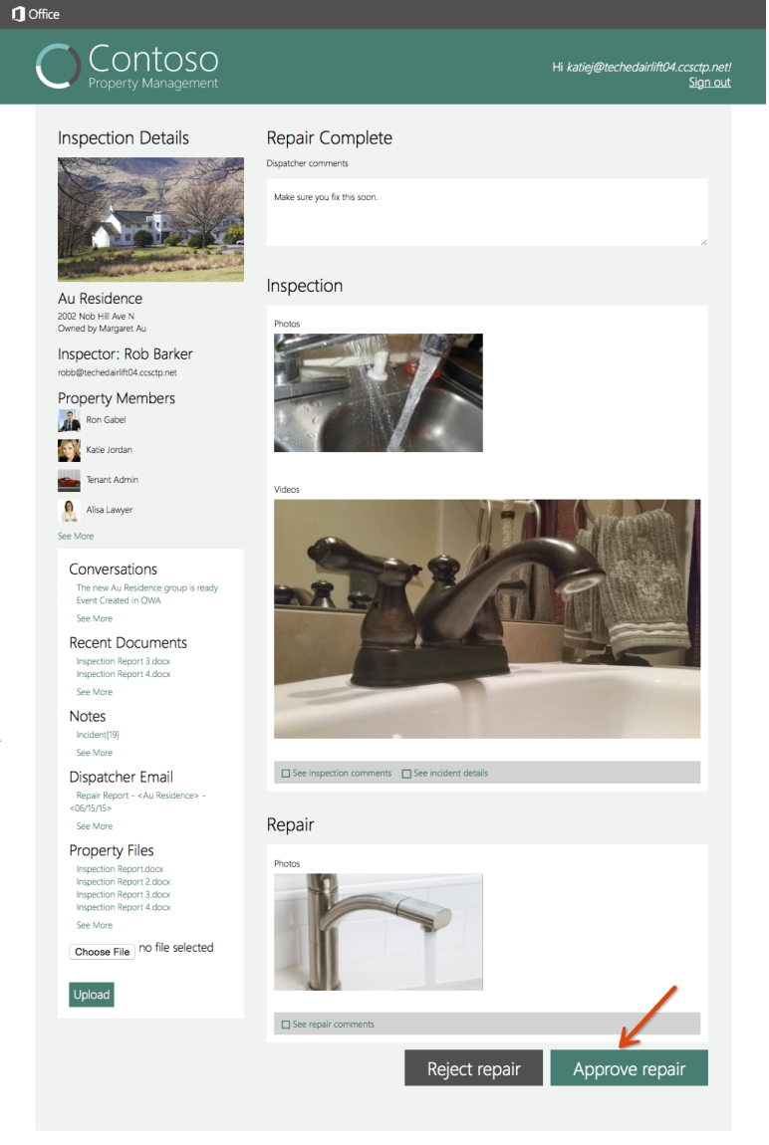
Review the repair person’s comments and photo and click Approve Repair
Workflow Task for dispatcher is completed
Incident is updated with Repair Approved Status and Date
Workflow History is updated to close workflow

Slide 71
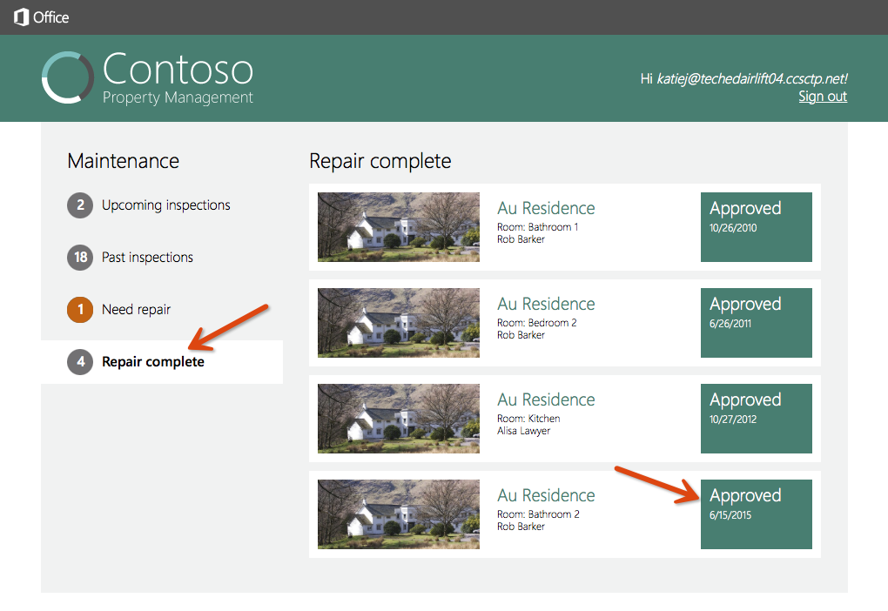
Refresh the Property Management Web App and click Repair complete to see the Approved status

